Slide 1
BUAN 5260: Mathematical Models for Decision Making (Constrained Optimization)
Week 3
Gareth Green
greeng@seattleu.edu

Slide 2
This week
More sensitivity analysis, uncertainty and solution stability (7.1 & 7.2)
Robust optimization (7.4)
Applications in R
Chance constraints (7.5)
Applications in R
Transportation problems (9.1)
Applications in R
Assignment problems (9.3)
Applications in R

Slide 3
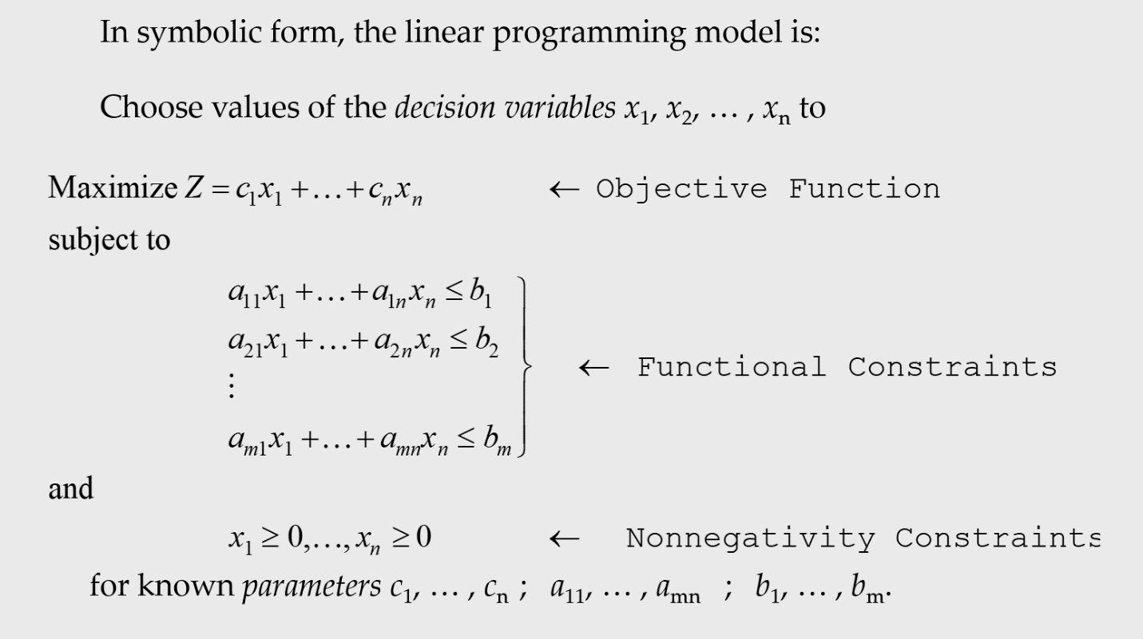
General modeling structure

Slide 4
Sensitivity analysis (Ch 7.1)
Which of the a’s, b’s, and c’s impact the results the most and least?
We discussed impact of b’s on profitability—duals
Determine what constraint should be increased next to increase profits
We discussed a’s and c’s impact on the solution
First, find critical a’s and c’s the model is sensitive to
Second, perform sensitivity analysis on critical a’s and c’s
If near a “switching value” the solution will be sensitive to it
The text demonstrates sensitivity analysis by changing values of the parameters and seeing the impact on the solution
R can be used to find exact of “switching values” coefficients

Slide 5
Applying sensitivity analysis (7.2)
 | Labor | Machine | Demand | Boots | Shoes
Solution | 1200 | 450 | 30 | 30 | 15
Duals/Coef | $1.25 | $0 | $2.50 | $40 | $25
Sens From | 900 | -∞ | 20 | $37.50 | $0
Sens Till | 1300 | ∞ | 40 | ∞ | $26.67
S
60
50
15
Objective function
-c_{B}/c_{S} = -40/25 = -1.6
How does the solution table relate to graph?
Duals show change in profit for each resource
Duals sens from/till show range of dual values
For example, in labor range 900-1300, change in profit will be $1.25 for additional labor
But B and S will change
Coef Sens from/till shows range variables not change
For example, B = 30 and S = 15 if $37.50 ≤ c_{B} ≤ $∞ and $0 ≤ c_{S} ≤ $26.67
But profit will change
Labor constraint
-a_{BL}/a_{SL} = -30/20 = -1.5
Machine constraint
-a_{BM}/a_{SM} = -10/10 = -1
30 40 50 B

Slide 6
Linear programming under uncertainty
Sensitivity analysis is testing the impact of a’s, b’s and c’s on solution
Make sure solution is stable
Which parameters is the solution sensitive too?
Investigate sensitive parameters for certainty
Make sure model gives realistic results
Testing coefficients is not the only step in in dealing with uncertainty
Robust optimization: finding a virtually guaranteed solution
Chance constraints: finding a “probability based” robust solution

Slide 8
Robust optimization (Ch 7.4)
In some cases it is necessary to insure that specific targets are achieved
Soft constraint—can be violated a bit
Not a critical constraint
Maybe more of a resource available at a slightly higher price
Deal with outside of the model
Hard constraint—cannot be violated
Guard against worst case scenario
Sometimes called “safety first rule”
Choose action with least risk of failure

Slide 9
Robust optimization
Use Homework #1, problem 4 as an example
max _{G,V}: π = 5G + 25V
subject to:
Inputs 5G + 40V ≤ 1245
Water 4G + 8V ≤ 300
and G ≥ 0, V ≥ 0
First discuss modeling approach
Then work through example code of techniques

Slide 10
Robust optimization
How you do robust optimization depends on the nature of your parameters
Independent parameters—can use range of parameters in model
Correlated parameters—more complex methods due to non-linearity
Can introduce a functional relationship between parameters
Along a column (decision variable) is still linear
Lower market production due to drought
But, profit per unit increase
Along a row (constraint) is non-linear
e.g. drought correlated to higher temps → plants need more H₂0
Can do in a “linear” fashion

Slide 11
Robust optimization—independent parameters
When estimating parameters you may learn the range of your parameters
Range consists of low and high value of variables
Which use (low or high) a, b and c depends on:
If the functional constraint is a “less than” or “greater than”
Less than (≤) functional constraint: use high a’s and low b’s
Greater than (≥) functional constraint: use low a’s and high b’s
Is the objective function maximization or a minimization
Maximization: use low value of c’s
Minimization: use high value of c’s
These are general rules
May not make sense in actual application if there is dependence between parameters

Slide 12
Robust optimization—dependent parameters
Generally, working with dependent parameters is quite technical
Replace parameters with functions of parameters
For example, suppose there is a drought
With independent parameters would use lower bound of water
With dependent parameters you might expect drought correlated to higher temperature so a’s larger
a_{VW} = f_{V}(W(Temp)), water supply and coefficient are a function of temperature
With dependent parameters you might expect lower production from drought correlated to result in higher prices for output
c_{VW} = f_{V}(∑V), profit for veggies is a function of the total supply of veggies
Instead could use fixed parameters based on best estimate for given conditions
max _{G,V}: π = 5G + 30V, 30 indicates higher profit, profit of grains stay the same (why?)
subject to:
Inputs 5G + 40V ≤ 1245, Materials: labor & production inputs stay the same
Water 4G + 8V ≤ 200, 5 and 10 assume use more water, 200 is drought
and G ≥ 0, V ≥ 0
Work an example in a little bit

Slide 13
Linear programming under uncertainty in R
Robust optimization with Independent parameters
Homework 1, problem 4 farming example
Lets consider the impact of a drought with independent parameters
c₁ = 5 with range 3 to 7
c₂ = 25 with range from 20 to 30
a₁₁ = 4 with range from 3 to 5
a₁₂ = 8 with range from 6 to 10
b₁ = 300 with range from 200 to 400
Input mix is known with certainty
Assume drought doesn’t require change in labor, machines, fertilizer, etc
How does using Robust Optimization impact the algebraic formulation?
Use high a’s, and low b’s and c’s
Will work through code in W3-2_robust_cc.Rmd file

Slide 15
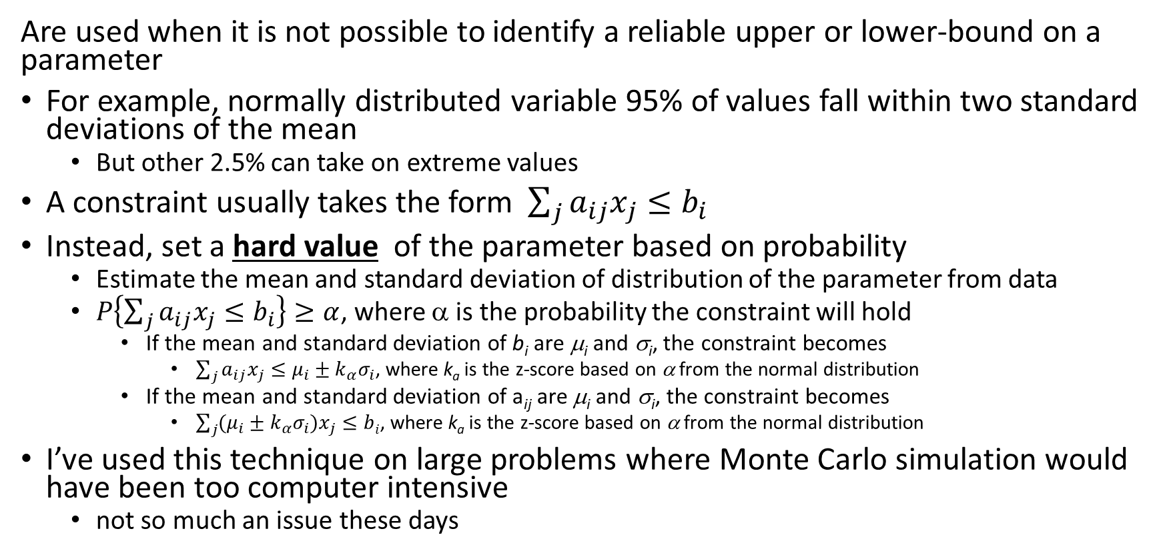
Chance constraints (Ch 7.5)
Are used when it is not possible to identify a reliable upper or lower-bound on a parameter
For example, normally distributed variable 95% of values fall within two standard deviations of the mean
But other 2.5% can take on extreme values
A constraint usually takes the form$\sum_{j}{a_{ij}x_{j}}≤b_{i}$
Instead, set a hard value of the parameter based on probability
Estimate the mean and standard deviation of distribution of the parameter from data
$P\left\{\sum_{j}{a_{ij}x_{j}}≤b_{i}\right\}≥α$, where α is the probability the constraint will hold
If the mean and standard deviation of b_{i} are μ_{i} and σ_{i}, the constraint becomes
$\sum_{j}{a_{ij}x_{j}}≤μ_{i}±k_{α}σ_{i}$, where k_{a} is the z-score based on α from the normal distribution
If the mean and standard deviation of a_{ij} are μ_{i} and σ_{i}, the constraint becomes
$\sum_{j}{(μ_{i}±k_{α}σ_{i})x_{j}}≤bi$, where k_{a} is the z-score based on α from the normal distribution
I’ve used this technique on large problems where Monte Carlo simulation would have been too computer intensive
not so much an issue these days

Slide 16
Chance constraints in R
Lets take a look at an application to the Farming problem
Homework 1, problem 4 farming example
Lets consider the probability of a drought
Suppose the weather data is well known so it’s possible to find a distribution
Water supply is distributed b_{W}~ N(μ_{W} = 300, σ_{W} = 50)
Will work through code in W3-2_robust_cc.Rmd file

Slide 18
Transportation and assignment problems (Ch 9)
Applications of linear programming
So far have focused on the Resource Allocation problem
Chapters 9, 10, 11 and 12 are all applications of linear programming other than resource allocation
However, they sometimes take different functions or software packages
For example, lpsolve has a special lp.transport() function
A key characteristic of transport and assignment problems is:
They have many decision variables x_{ij}’s and many with x_{ij} = 0 in solution
Many of the a_{ij}’s are zero because a constraint maybe unrelated to many variables
We’ll look at two ways of setting the problems up
Classic lp
Cost matrix with row and column constraints

Slide 19
Transportation problem (Ch 9.1)
The usual objective: ship materials/products from multiple sources to multiple destinations at least cost
Sources have different costs of production and/or capacity
Destinations have different costs of delivery and/or demand
Each source/destination pair is a decision variable and has a constraint
If have 4 sources and 5 destination have:
20 decision variables
9 constraints
ALWAYS draw a graphic to better understand the problem

Slide 20
Transportation problem
Usual data is:
Cost of production at different sources
Production capacity at different sources
Cost of delivery to a destination
Demand or capacity at destination
What if you are trying to do it least cost and least time?
Unfortunately can only have one objective
Need to convert time to cost or cost to time
Can only have one objective function for all constrained optimization

Slide 21
Transportation problem
The pattern of the non-zero and zero coefficients is what makes the transportation problem unique
Not that it is transportation
We can reduce the dimensionality of the problem by reformatting as a cost matrix
Must include row and column constraints—will show in code
Classic form give Regular set up is (n + m + 1) rows and (m + 1)(n + 1) columns
Transport set up has m rows and n columns
The reduced dimensionality can reduce computation time on large problems
Modeling challenge: some sources cannot supply some destinations
To capture this in the model include a high cost
High cost is defined relative to other costs in the model
Magnitude of 10 or 100 larger than cost on other routes

Slide 23
Transportation problem in R
When programming be sure to begin with these 3 questions:
What is the decision being made
What are the constraints on these decisions
What is the measure of performance
Best practices for successful formulation of the problem
Draw a diagram of the problem
Write out the mathematical formulation
Begin coding
Too often students try to begin by coding first and get lost in the dimensions

Slide 24
Transportation problem in R
Use code that first use lpSolveAPI and then lpSolve to show the difference
Begin with W3-3_trans_9_1_ex1.Rmd
First code full problem in lpSolveAPI
Show how set up lp problem in lpSoveAPI from text file
Show same as above with variable names
Second, show same problem in lpSolve using lp.transport( ) command
Can load table of data like in textbook
Note the ROW RHS and COLUMN RHS
This is how lp.transport() is different!
Important difference in number of computations!!
Regular set up is (n + m + 1) rows and (m + 1)(n + 1) columns
Transport set up has m rows and n columns
Third, demonstrate example 2 with dummy destination by loading a text file
Regular set up is (n + m + 1) rows and (m + 1)(n + 1) columns
Transport set up has m rows and n columns

Slide 25
Transportation problem in R
The remaining of this session will follow through the code files below (W3 is week 3):
W3-2_robust_cc.Rmd (already reviewed)
W3-3-1_trans_9_1_ex1.Rmd
W3-3-1_generic_ex1.lp
W3-3-1_trans_9_1_ex1.lp (trans means transportation problem)
W3-3-1_trans_9_1_ex1.csv (problem data)
W3-3-2_trans_9_1_ex2.Rmd
W3-3-2_trans_9_1_ex2.lp
W3-3-3_trans_9_1_ex3.Rmd
W3-3-3_trans_9_1_ex3.csv (problem data)
W3-4-1_as_9_3_ex1.Rmd (as means assignment problem)
W3-4-1_as_9_3_ex1.csv (problem data)
W3-4-2_as_9_3_ex2.Rmd
W3-4-2_as_9_3_ex2.csv (problem data)

